Slide 1
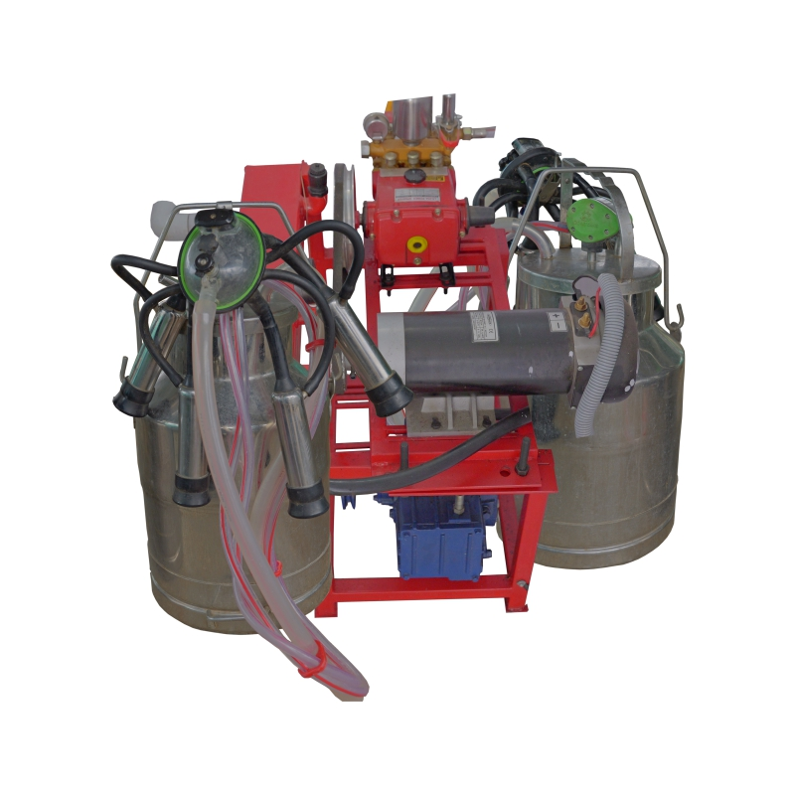
Milking Machine
Enterprise Name | Smart Agro Machinerys
Model Name | SAM Milking Machine 400S
Model No | NA
Tank Capacity | 25 Liters.
Type(Cluster) | Double Cluster
Number of Tanks: | Single Bucket
Power | 1.5 HP
Voltage | 48 V
Warranty | 1 Year
Usage/Application | NA
Suitability | NA
Impact | NA
Indicative Solar Design*(Assumption: Working Hours - 2 hours, Days of Autonomy - 2, Average of Sunshine 5)
Solar Panel | 1600 Wp
Battery | 200 ah, 48V
PCU /Charge Regulator | 22 – 25 Cattles
Price | 65,000

